Slide 1
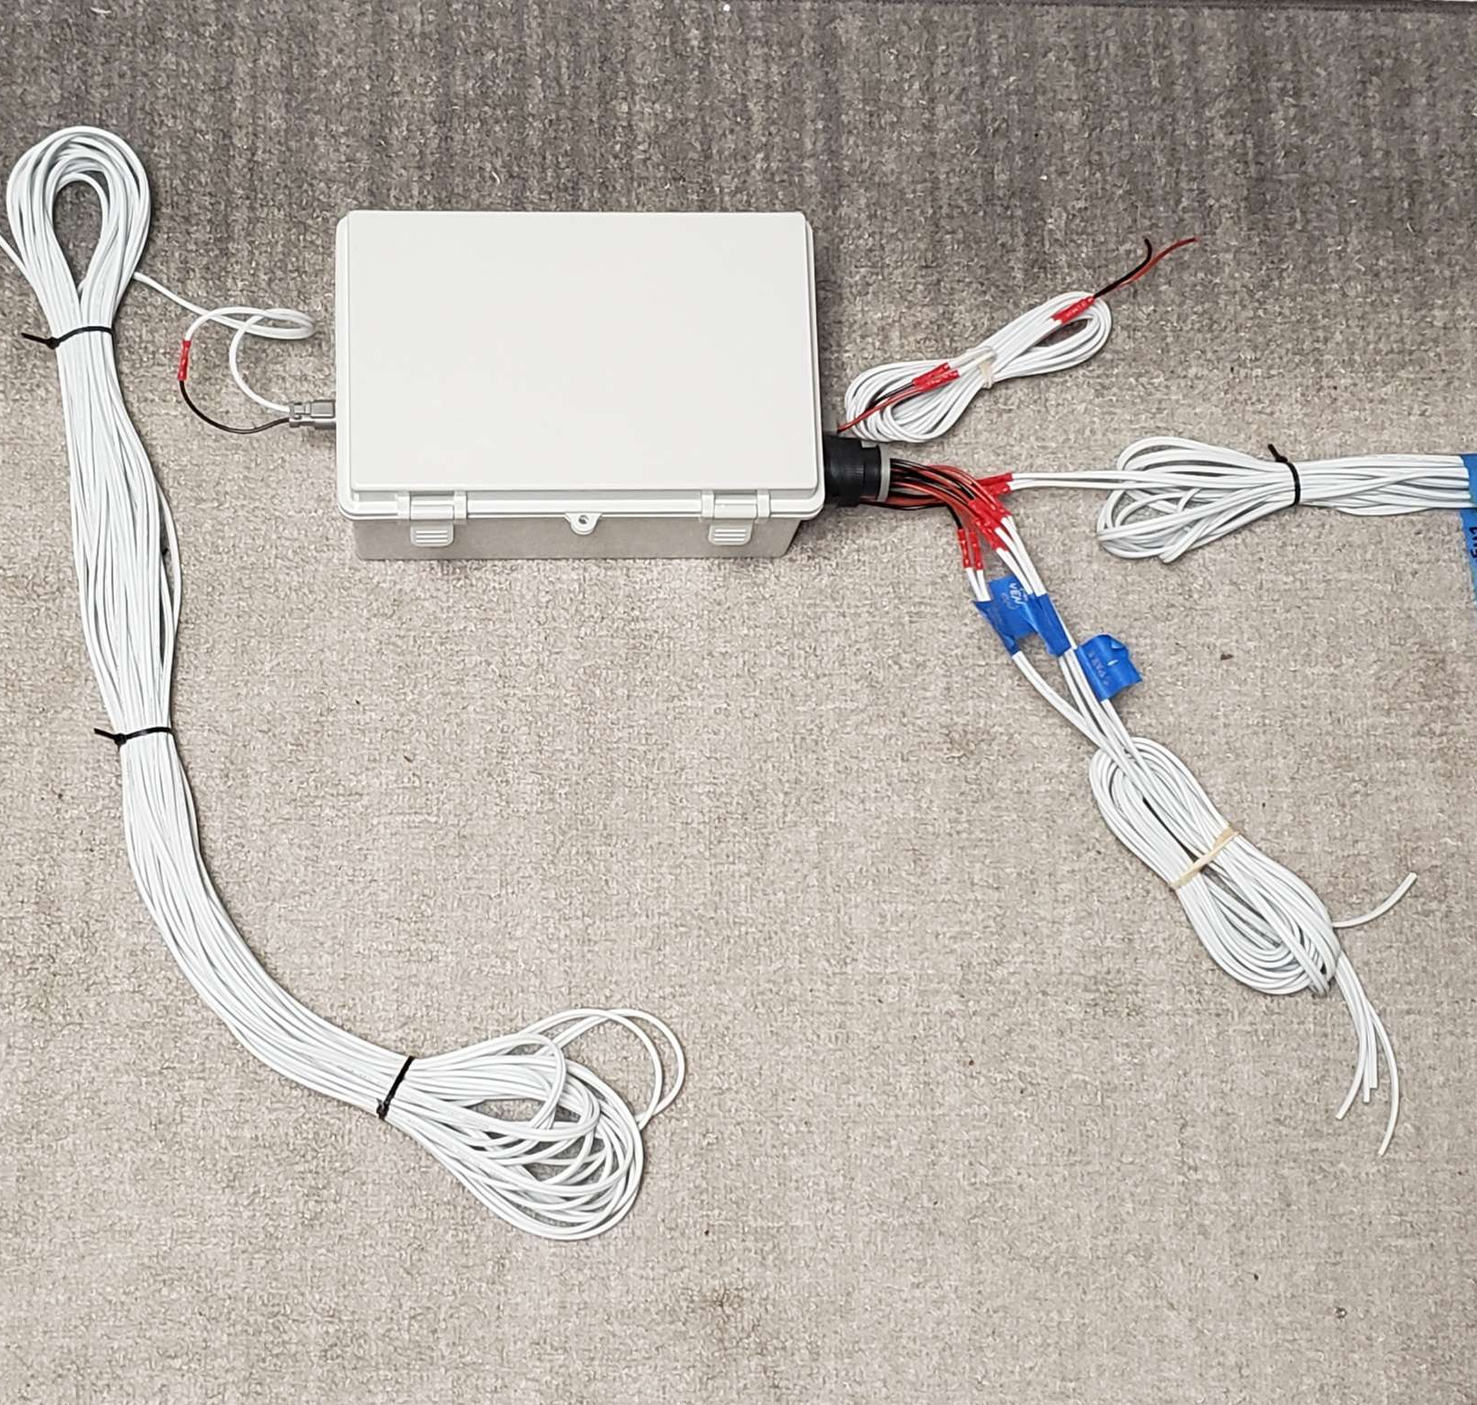
TESTING ELECTRONICS | ASSEMBLY & TESTING
UPDATES
Actuator box successfully ignited an igniter using its power system.
AB code foundation built to not use the delay() function in Arduino. Instead, it uses various watch timers using millis() to prevent downtime within the main loop.
Code is designed to heavily rely on objects to make the main code be as high level as possible.
REMAINING TO DO
Finish AB code to receive CAN messages and send back the status report to the control box.
Code control box to send and receive CAN messages from AB.
CAN communication with engine node.
Edge case testing and emergency scenario software procedure.

