Slide 1
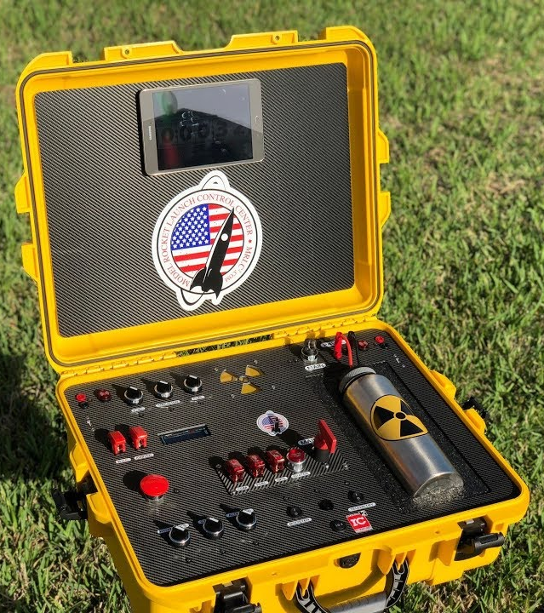
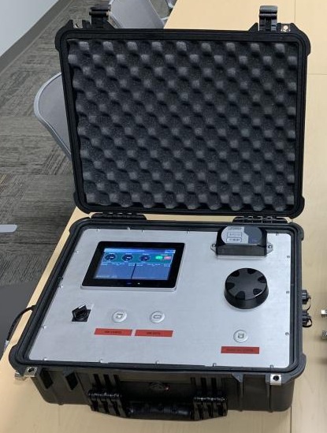
TESTING ELECTRONICS | Diagrams
UPDATES
Logic diagram
Power block diagram started
REMAINING TO DO
Finalize power block diagram and select components
Component trade studies
Preliminary mechanical design
PDR: 9/30/22

