Slide 1
TESTING ELECTRONICS | YEAR PROGRESS
COMPLETED THIS YEAR
Complete redesign of the testing electronics
  Primary objective to increase reliability and decreasing setup time and complexity
Designed 3 PCBs for better reliability at the cost of flexibility
Assembled the actuator box to control the engine/fluid panel and the control box to interface with the controller
Successful operation during SCF1 and SET1
  Setup time reduced to ~10 minutes
  Total of 4 wire harnesses: fluid panel, igniter, BVAS, and main comms line
TODO
Minor software changes to ensure that a weird edge case never prevents us from reestablishing comms
Add/wire panel mount for new servo valve to replace the pneumatic BVAS
  Code the servo control with the time steps for the angle/opening speed
Test the new software changes, particularly any changes to relay control logic and the new servo valve

Slide 2
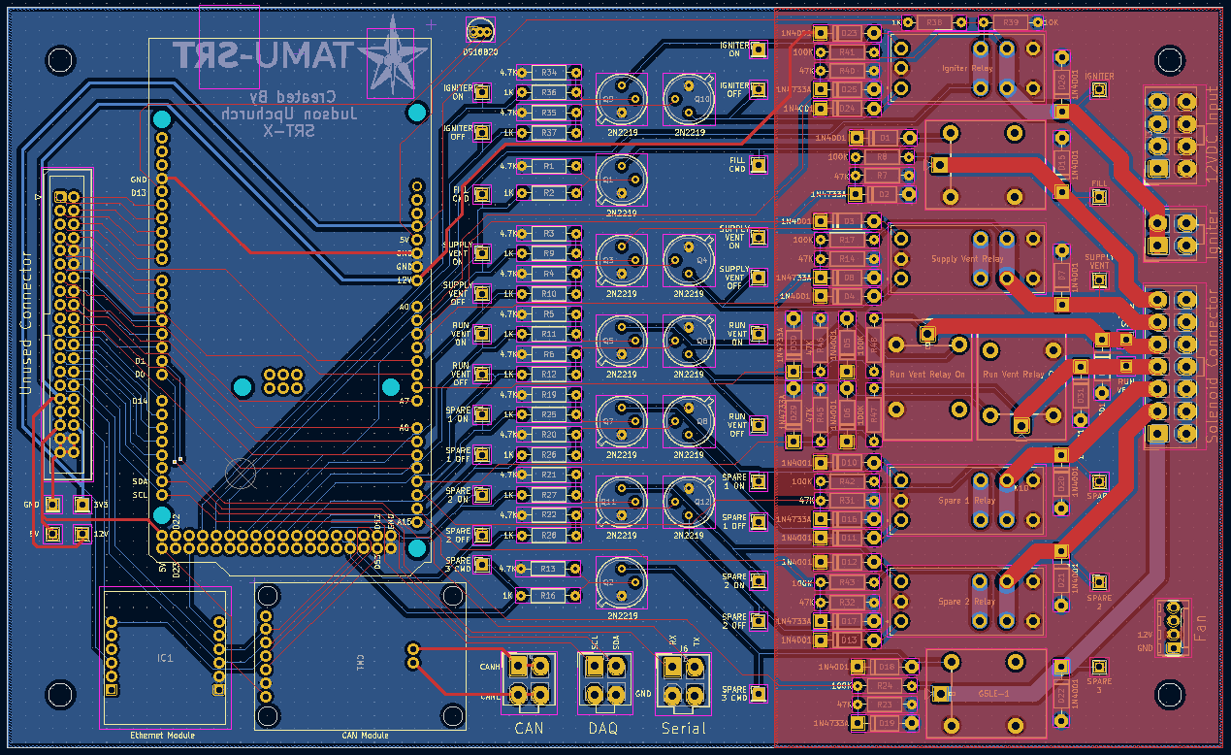
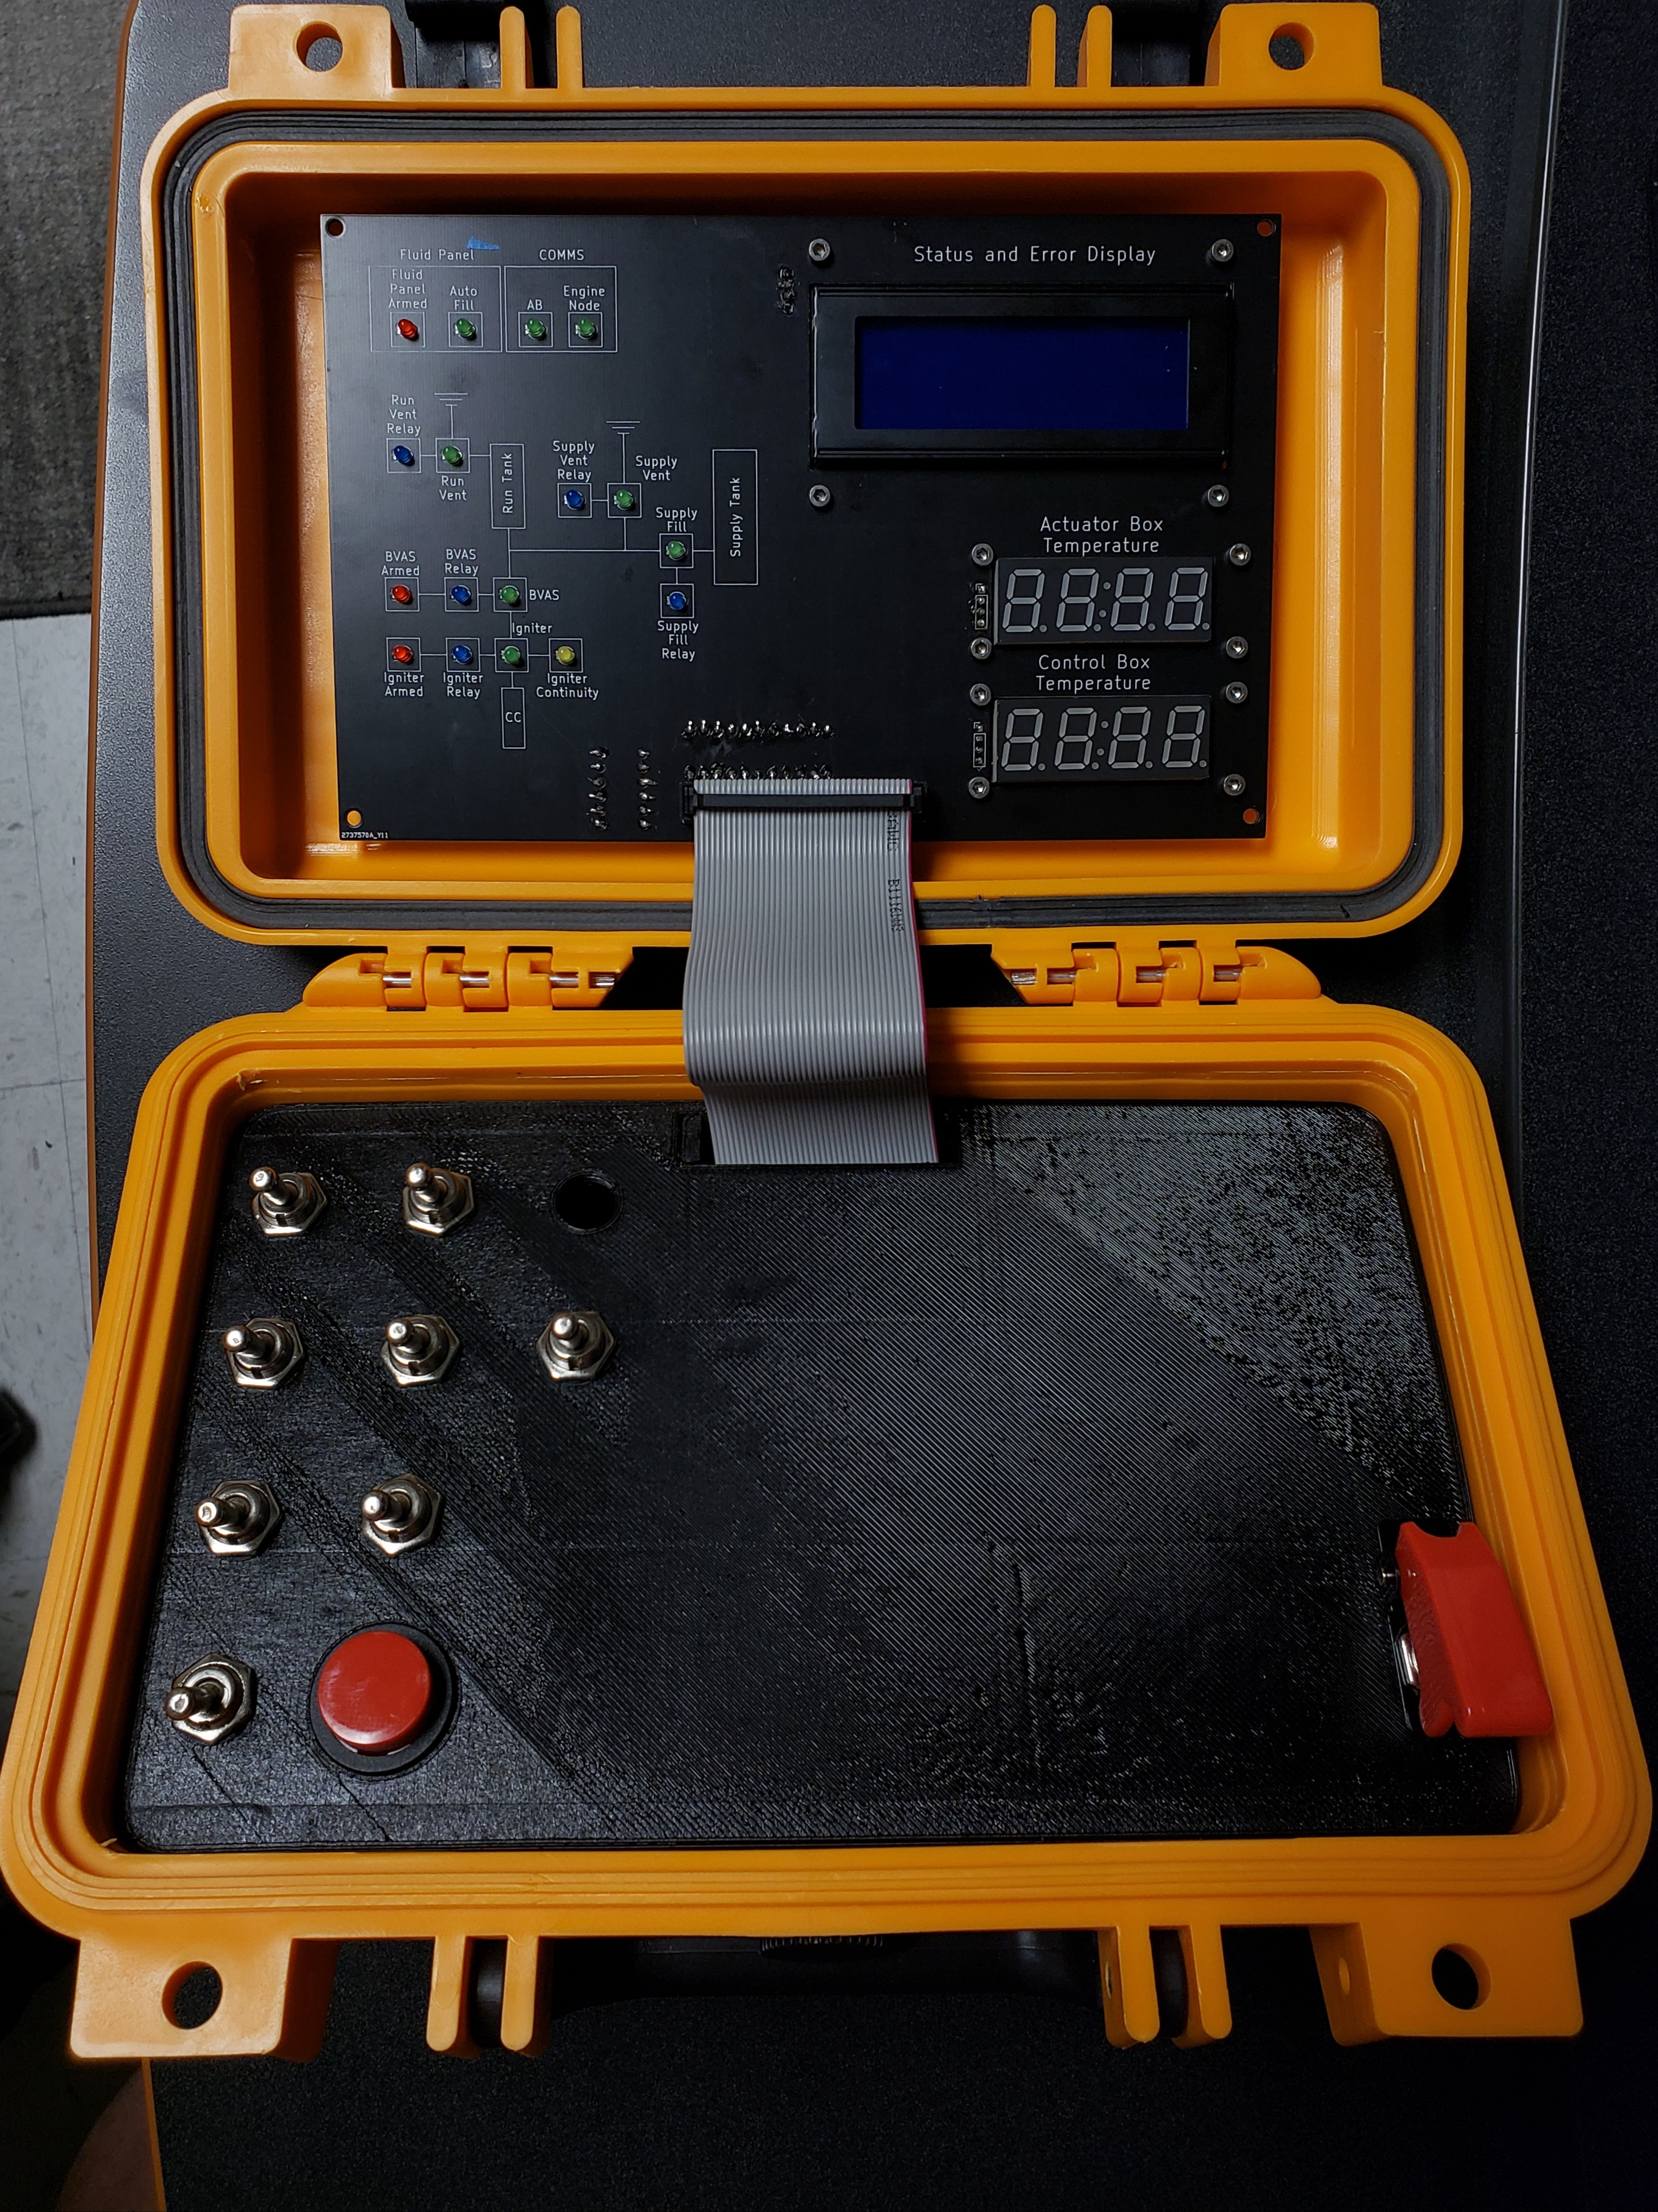
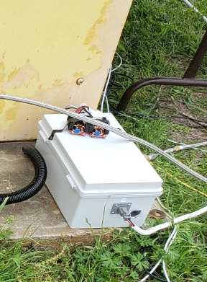
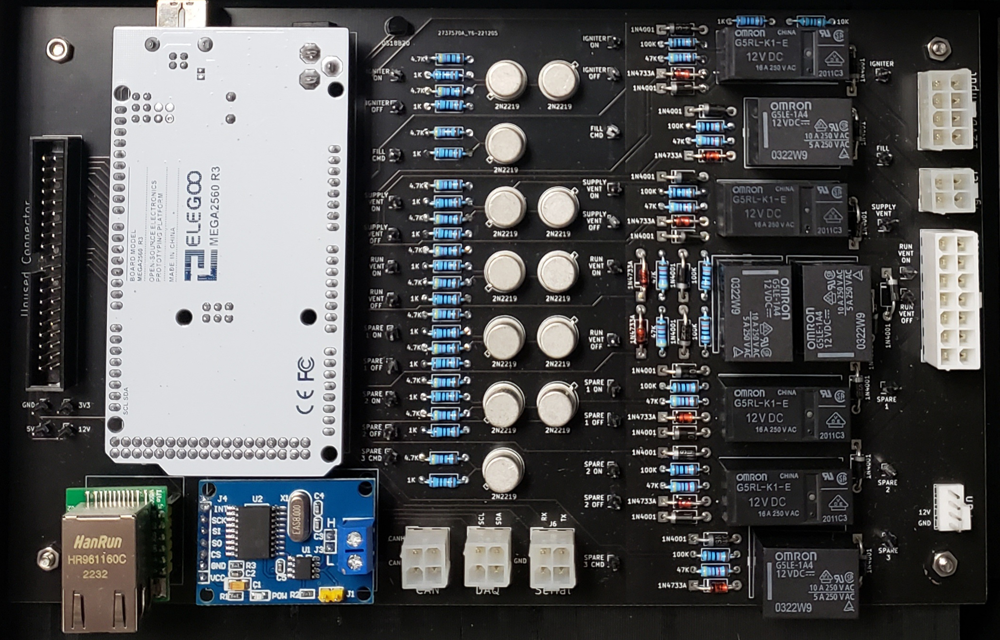
TESTING ELECTRONICS | YEAR PROGRESS

