Slide 1
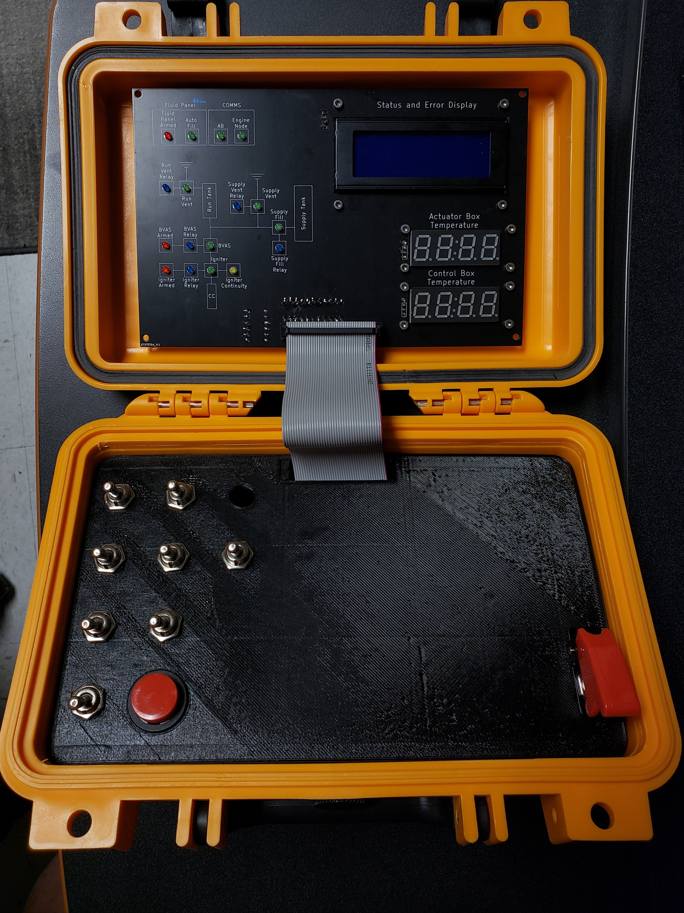
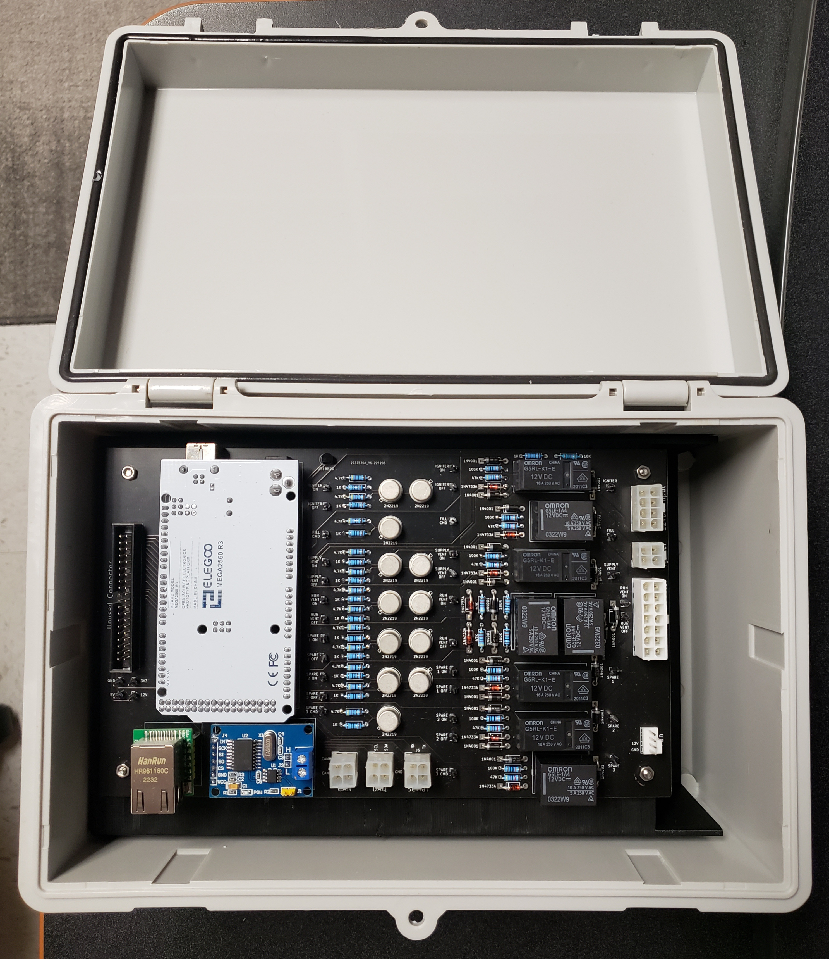
TESTING ELECTRONICS | PROGRESS & SCHEDULE
Construct wire harnesses
Full system assembly
February 2nd
System orientation
February 4th
Communications test
Actuation tests
February 7th
Rigorous emergency state handling, communication tests, thermal tests, and control loop testing
February 14th
SET ready

