Slide 1
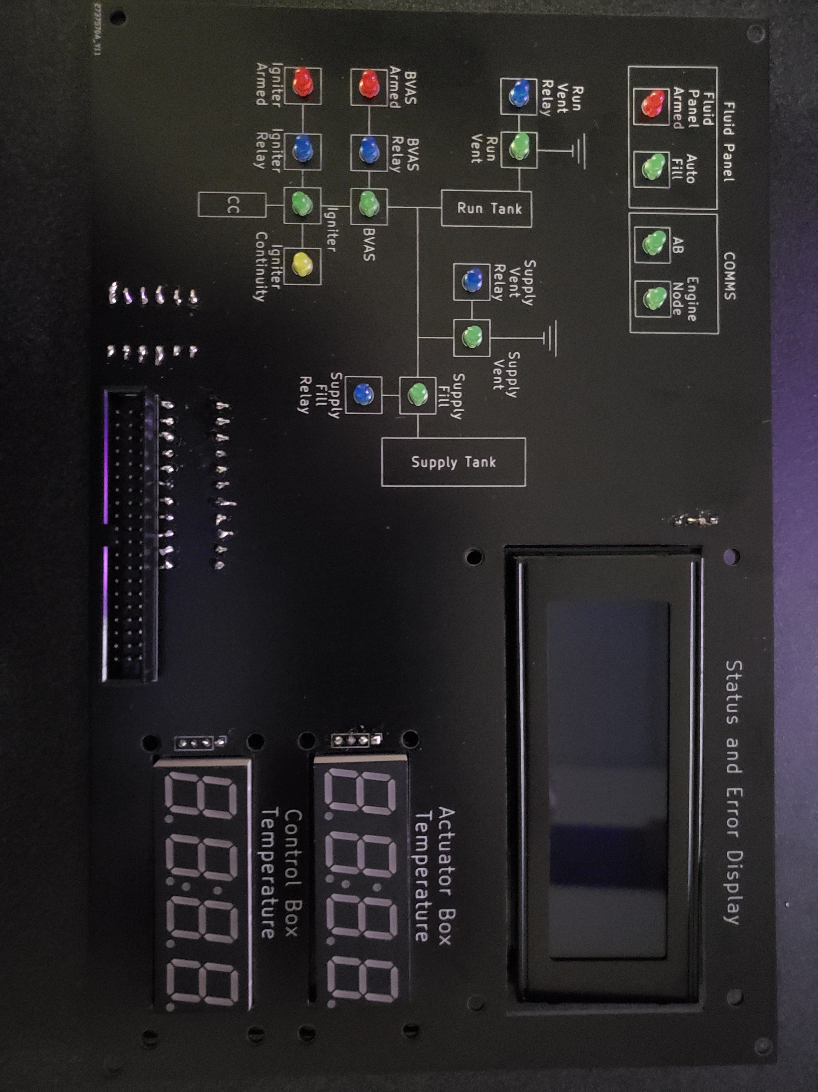
TESTING ELECTRONICS | ASSEMBLY
UPDATES
Actuator Box PCB assembled
Control Box main board and Display Board assembled
3D printing interior mounting brackets
REMAINING TO DO
Assemble components in each housing
Make wire harnesses/connectors for power and data lines
System testing using TOPS procedure scripts

