Slide 1
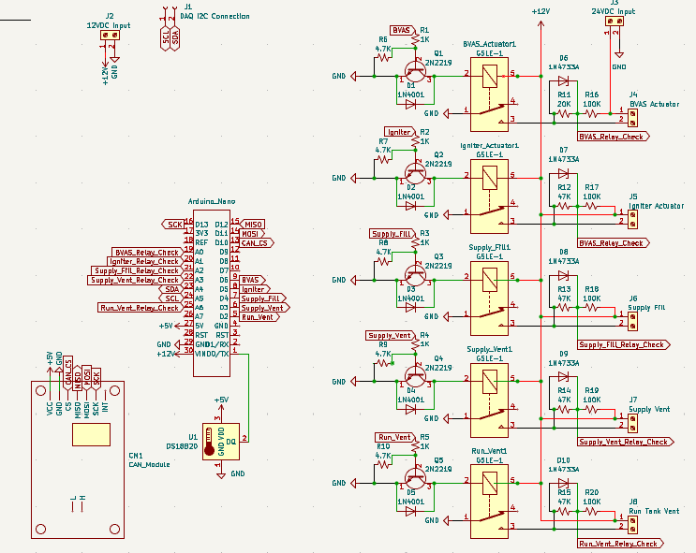
TESTING ELECTRONICS | SCHEMATICS AND CAN COMMUNICATION
UPDATES
Continued development on Actuator Box schematic.
Started CAN Bus transceiver with Arduino.
REMAINING TO DO
Control Box schematic.
Actuation Box software block diagram.
Continue CAN Bus transceiver tests with Arduino.
Define CAN packet structure for commands and data reports.

