Slide 1
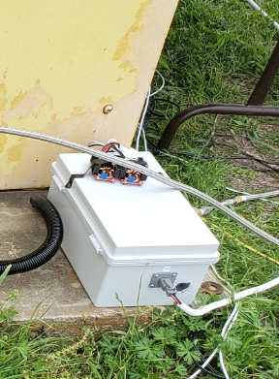
TESTING ELECTRONICS | SET1
UPDATES
Reduced latching relay latency from 1000ms to ~250ms
Rewrote all relay classes to be cleaner and easier to code with
  Auto error detection
  Simply set desired relay state and continuously run the control loop
TODO/SET READINESS
Switch two wires to solve BVAS issue
SCF proved the system is functional, will run the same code that we had during the SCF

