Slide 1
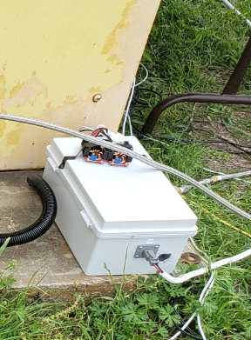
TESTING ELECTRONICS | STATIC COLD FLOW & SET READINESS
SCF SETUP
Took less than 10 minutes to set up for an SCF.
Only 3 wire harnesses: 1 to the engine for BVAS control, 1 to the fluid panel, and 1 from the test cell to the control room.
SCF OPERATION
Boxes connected automatically and stayed connected
Fluid panel control was nominal with good readbacks
BVAS control had the open and close solenoids switched in the wiring. Worked around by treating “ON” as “OFF” and vice-versa.
TODO/SET READINESS
Switch two wires to solve BVAS issue (5 minute fix)
SCF proved the system is functional. Only addition for an SET is the igniter which has been independently tested.

