Slide 1
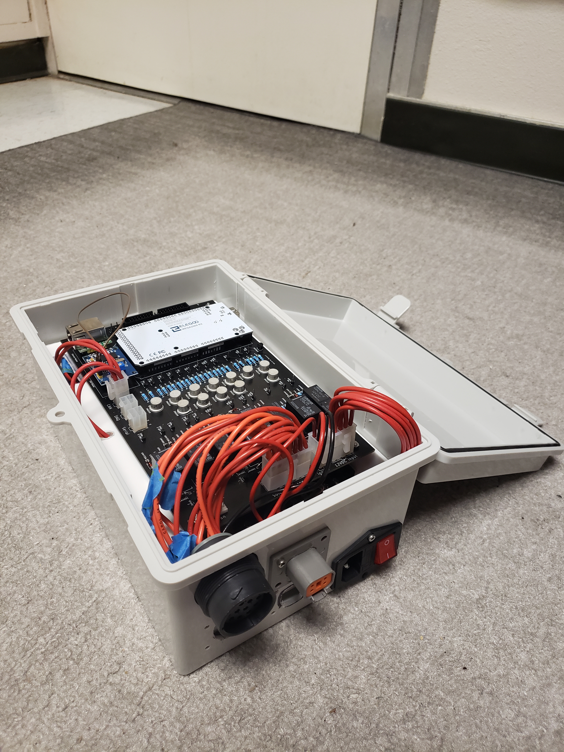
TESTING ELECTRONICS | ASSEMBLY & TESTING
UPDATES
Interior wire harnesses mostly completed.
Started working on exterior harnesses.
Successful 85ft CAN communication test.
REMAINING TO DO
Finish interior/exterior harnesses.
Integrated testing of the boxes.

