Slide 1
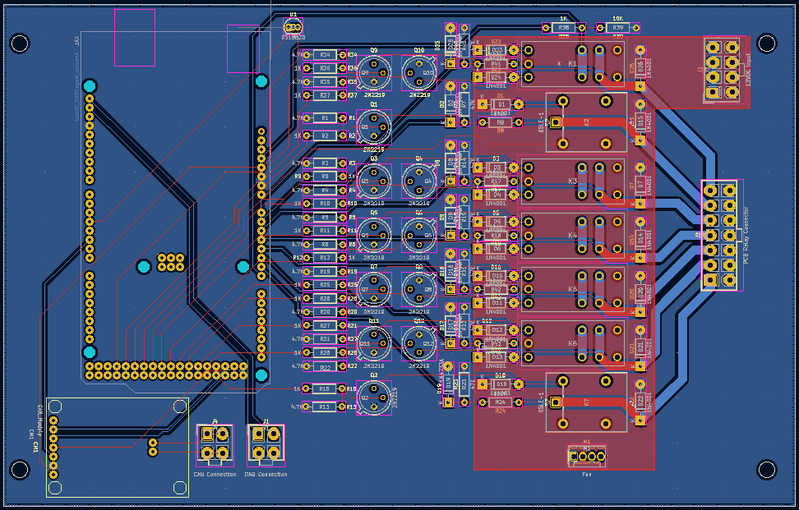
TESTING ELECTRONICS | PCB DESIGN
UPDATES
Actuator Box PCB in review stage
Changed to use latching relays in case of disconnects
TARGET DEADLINES
December 1st
  Review Actuator Box PCB and order
  Finish Control Box PCB, review, and order
January 23rd
  3D model and print electronics mount for Control Box
  Assemble Control Box and Actuator Box
February 3rd
  Testing

