Slide 1
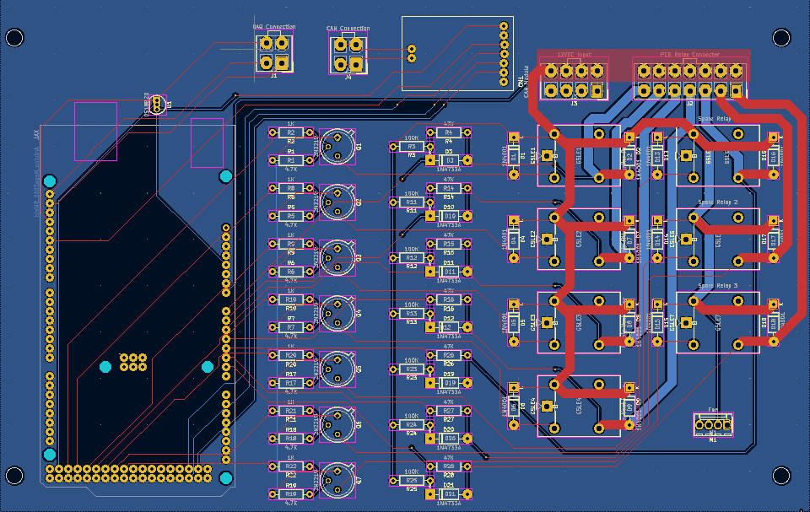
TESTING ELECTRONICS | PCB DESIGN
UPDATES
Parts ordered
Actuator Box PCB in review stage
FEATURES
Latching connectors for power delivery and panel connectors
Socketable Arduino Mega and CAN Module for easy removal and testing

Slide 2
TESTING ELECTRONICS | CONSTRUCTION & TESTING
TARGET DEADLINES
December 1st
  Review Actuator Box PCB and order
  Finish Control Box PCB, review, and order
January 23rd
  3D model and print electronics mount for Control Box
  Assemble Control Box
  Assemble Actuator Box
Testing: comms, power system, thermal, igniter, fluid system, failsafe conditions

