Slide 1
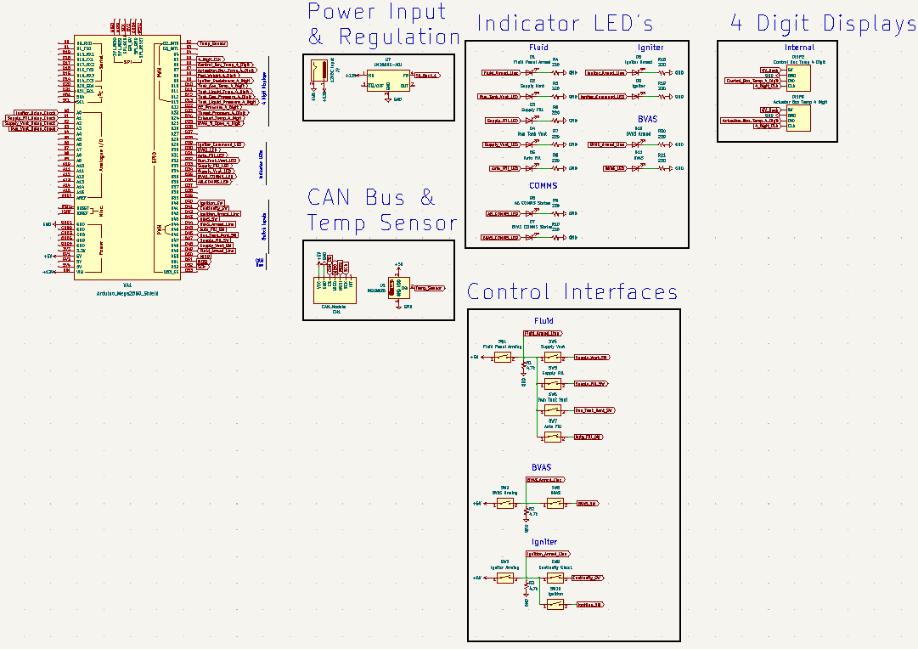
TESTING ELECTRONICS | SCHEMATICS AND CONSTRUCTION
UPDATES
Control Box schematic complete
REMAINING TO DO
Create BOM for Actuation Box and Control Box
Order parts
PCB for Control Box
PCB for Actuation Box

