Slide 1
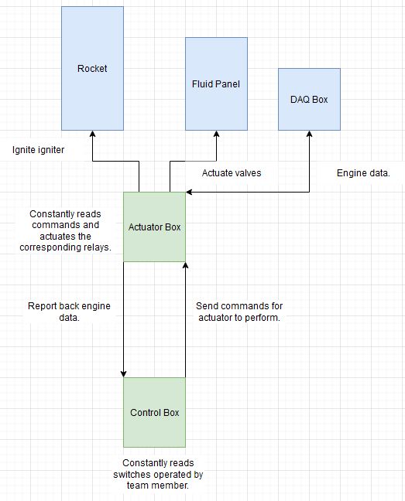
TESTING ELECTRONICS | PDR SUMMARY
Physical Interfaces
Control Box:
Pelican case with the lower panel housing switches, buttons, and any other control inputs.
The upper panel will have 7 segment displays and LEDs to report engine data and status indicators.
Actuator Box:
Single node system located near the engine to control the fluid actuators, igniter, and report data from the DAQ back to the Control Box.
Communication
CAN Bus between the Control Box and Actuator Box connected via a single 2-wire harness.
I²C between the Actuator Box and DAQ.

Slide 2
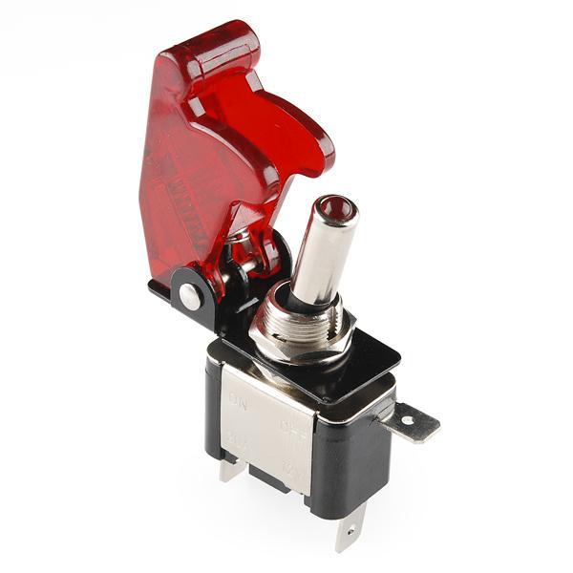
TESTING ELECTRONICS | PDR SUMMARY
Control Box Safety Considerations
Plastic covers over specific switches to prevent accidental operation.
Arming switches for each system (fluid, igniter, BVAS).
Actuator Box Safety Considerations
Every CAN message sent to the Actuator Box is verified by sending back a copy of what the Actuator Box received.
Both the Control Box and Actuator Box will always be sending and receiving CAN messages on a specific interval. If that communication is lost we can set specific failsafe actions to return the engine to a safe state.
The Actuator Box will have a separate digital circuit along side it that will be used to detect a failure of the microcontroller itself and return the engine to a safe state if that happens.

Slide 3
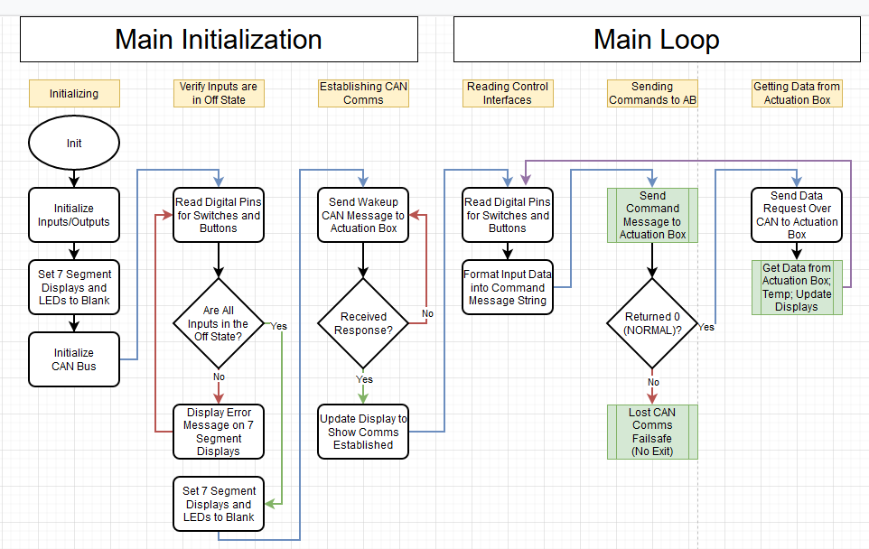
TESTING ELECTRONICS | SOFTWARE AND SCHEMATICS
UPDATES
Control Box software block diagram
Started Actuation Box schematic
REMAINING TO DO
Control Box schematic
Control Box Arduino development
Finish Actuation Box Schematic
Actuation Box software block diagram
Actuation Box Arduino development

