Slide 1
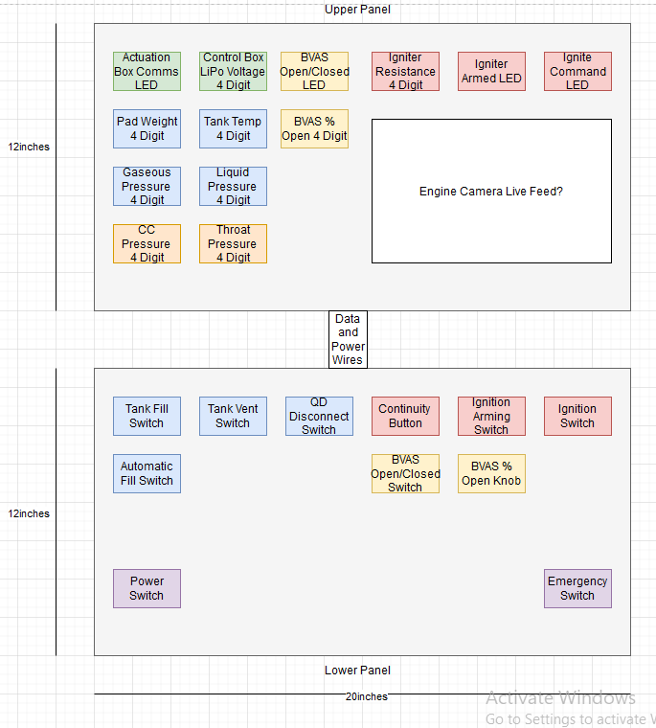
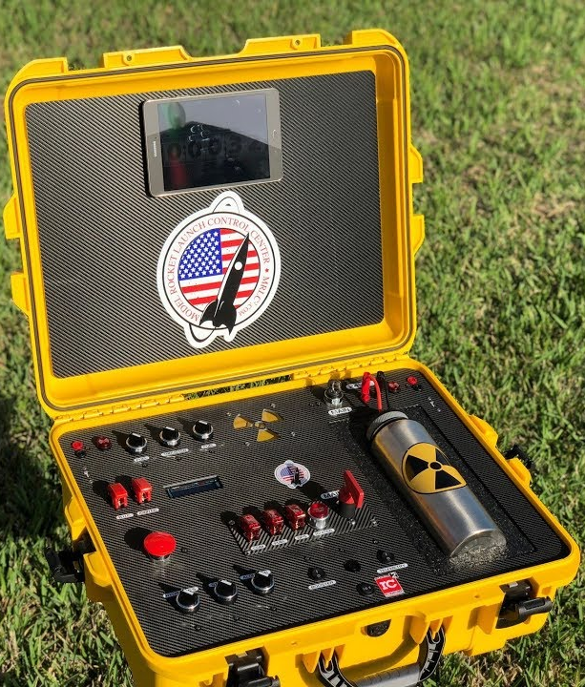
TESTING ELECTRONICS | Diagrams
UPDATES
Microcontroller trade study completed – selected Arduino Mega 2560
Communication protocol trade study completed – selected CAN bus
Preliminary layout of control box
Preliminary BOM
REMAINING TO DO
Power block diagram
Communications diagram
Mechanical components for control box
PDR: 10/7/22

