Slide 1
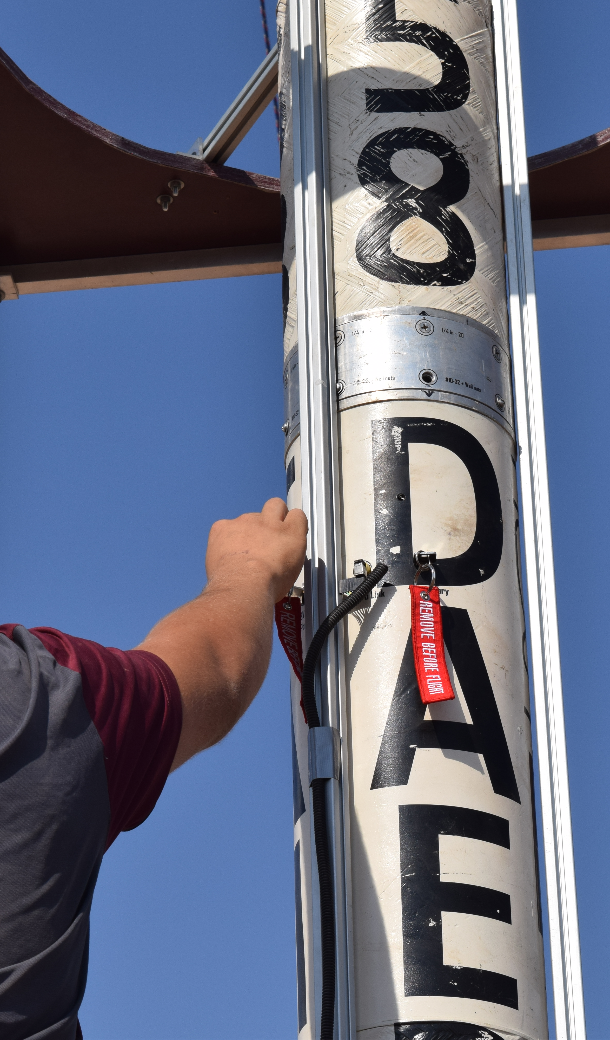
TESTING ELECTRONICS PDR
FALL WEEK 5 | 22.10.7
Rappa, Alexis
Upchurch, Judson

Slide 2
PROGRESS REPORT
COMPLETE
IN PROGRESS
POSTPONED
REQUIREMENT ID | DESCRIPTION | VERIFICATION METHOD
 |  | A | I | D | T
1.0.A | The system shall control all fluid solenoids. |  |  | D
1.1.A | The system shall return the current state of the fluid system to the operator at all times. |  |  | D
1.2.A | The system shall default to using a "manual fill" procedure. | A
1.3.A | The system shall use an "automatic fill" procedure upon receiving a command from the user. |  |  | D
1.4.A | The system shall feature visual indications on its' mechanical interface that indicate the state of the fluid control system. |  | I
2.0.A | The system shall be able to activate the rocket's ignitor. | A
2.1.A | The system shall set off ignitors with a 99.9% success rate or higher during ignitor tests and engine tests. |  |  |  | T
2.2.A | The system shall contain at least two (2) switches for ignitors, which must both be activated for ignition to occur | A
2.3.A | The system shall be capable of checking continuity of ignitors without setting them off |  |  | D
2.4.A | The system shall feature visual indications for the user that indicate the igniter has been activated. |  |  | D

Slide 3
PROGRESS REPORT
COMPLETE
IN PROGRESS
POSTPONED
REQUIREMENT ID | DESCRIPTION | VERIFICATION METHOD
 |  | A | I | D | T
3.0.A | The system shall actuate the flow of nitrous from the run tank into the combustion chamber |  |  | D
3.1.A | The system shall contain an emergency control which vents the run tank upon activation | A
3.2.A | The system shall feature visual and/or audible indications for the user that indicate the nitrous flow valve has been opened. |  | I
4.0.A | The system shall communicate with rocket's onboard systems and with the Control Station via wired connections |  |  | D
5.0.A | The system shall return the current pad weight of the engine to the operator at all times |  |  | D

Slide 4
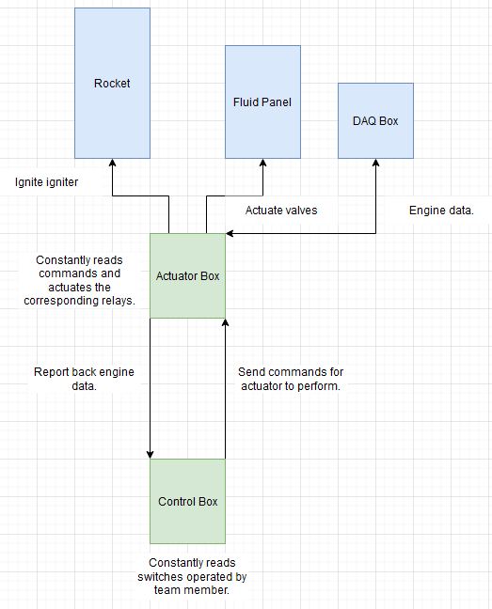
TSE PDR | CONOPs
The team member will utilize the control box to operate different aspects of the SET.
The control box will relay those inputs to the actuator box for it to perform the corresponding actions.
The actuator box will also get data from the DAQ and report back to the control box for it to display.

Slide 5
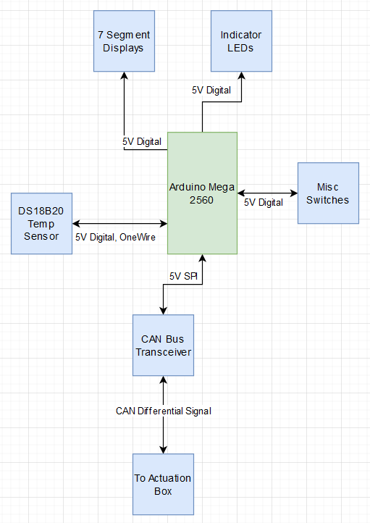
TSE PDR | CONTROL BOX COMMUNICATIONS AND DATA HANDLING
  The control box primarily reads a series of switches and transmits their states to the actuation box.
  The box will monitor these switches with 5V digital inputs.
  The box will transmit any commands to the actuator box via a CAN Bus that is interfaced via an SPI module.
  The box will also show the values of necessary engine data on a series of 7 segment displays and indicator LEDs.

Slide 6
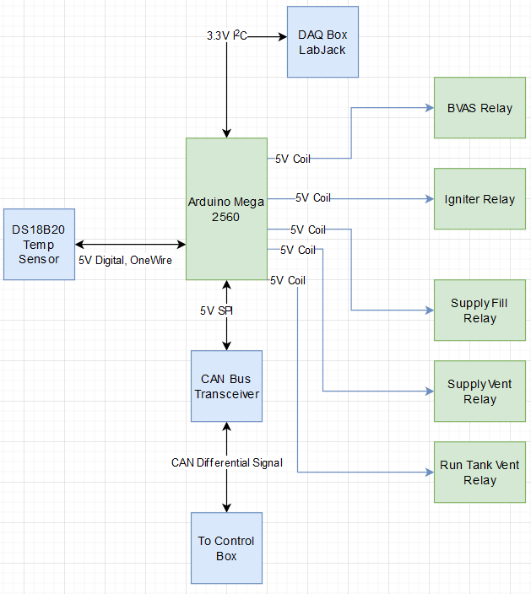
TSE PDR | ACTUATION BOX COMMUNICATIONS AND DATA HANDLING
  The actuation box primarily controls a series of relays via 5V digital signals to energize and de-energize coils.
  The box will receive necessary engine data via an I²C link to the DAQ box’s LabJack.
  The box will receive commands and transmit data via a CAN Bus that is interfaced via an SPI module.

Slide 7
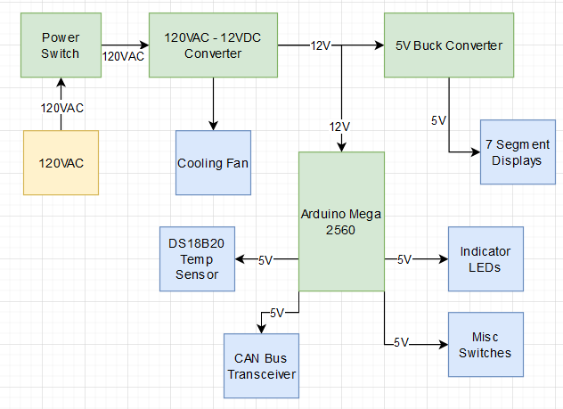
TSE PDR | CONTROL BOX POWER
  The control box will be powered via an AC power cord from the wall.
  Inside will step that down to 12VDC which will be used in conjunction with 5V to power the rest of the system.

Slide 8
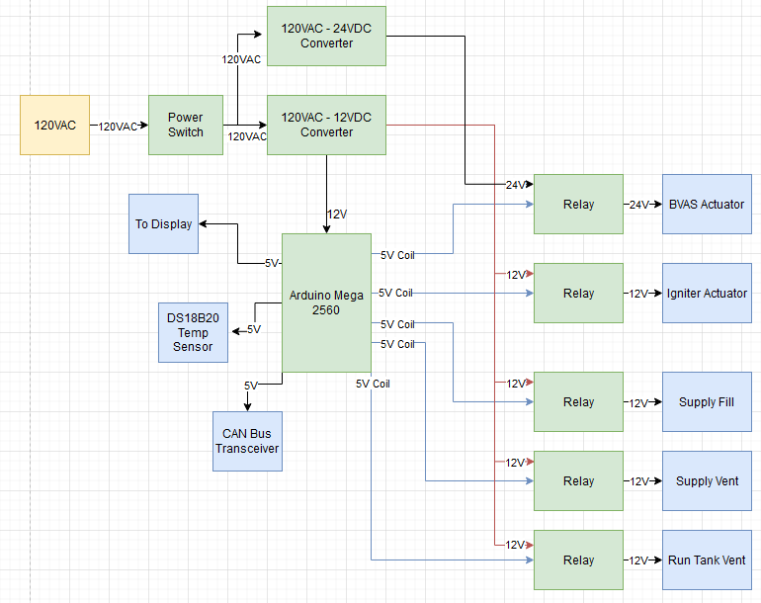
TSE PDR | ACTUATION BOX POWER
  The actuation box will be powered via an AC power cord from the wall.
  Inside will step that down to 12VDC which will be used in conjunction with 5V to power most of the system.
  A 24VDC step down will also be utilized for any BVAS control or other interfaces that require 24VDC.

Slide 9
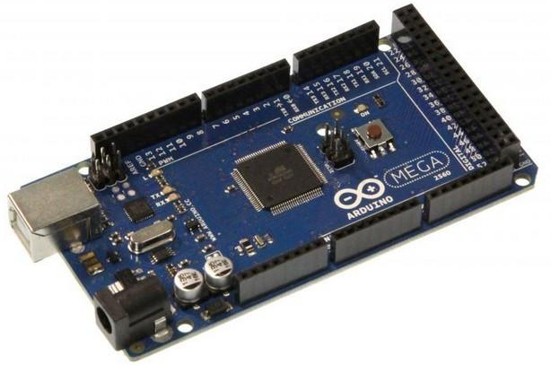
TSE PDR | MICROCONTROLLER SELECTION
MICRO- CONTROLLER | POWER DRAW (mW) | MAX PIN CURRENT (mA) | # DIGITAL PINS | # ANALOG PINS | TEMPERATURE RATING | COST
Arduino Uno | 230 | 20 continuous, 40 burst | 14 | 6 | -40°C - 85°C | $18
Arduino Mega 2560 | 270 | 20 continuous, 40 burst | 54 | 16 | -40°C - 85°C | $20
Teensy 4.1 | 500 | 10 | 35 | 18 | -40°C - 85°C | $37
SELECTION: Arduino Mega 2560
RATIONALE:
  Plenty of digital pins for the numerous inputs and outputs required.
  Well established documentation with selected hardware.

Slide 10
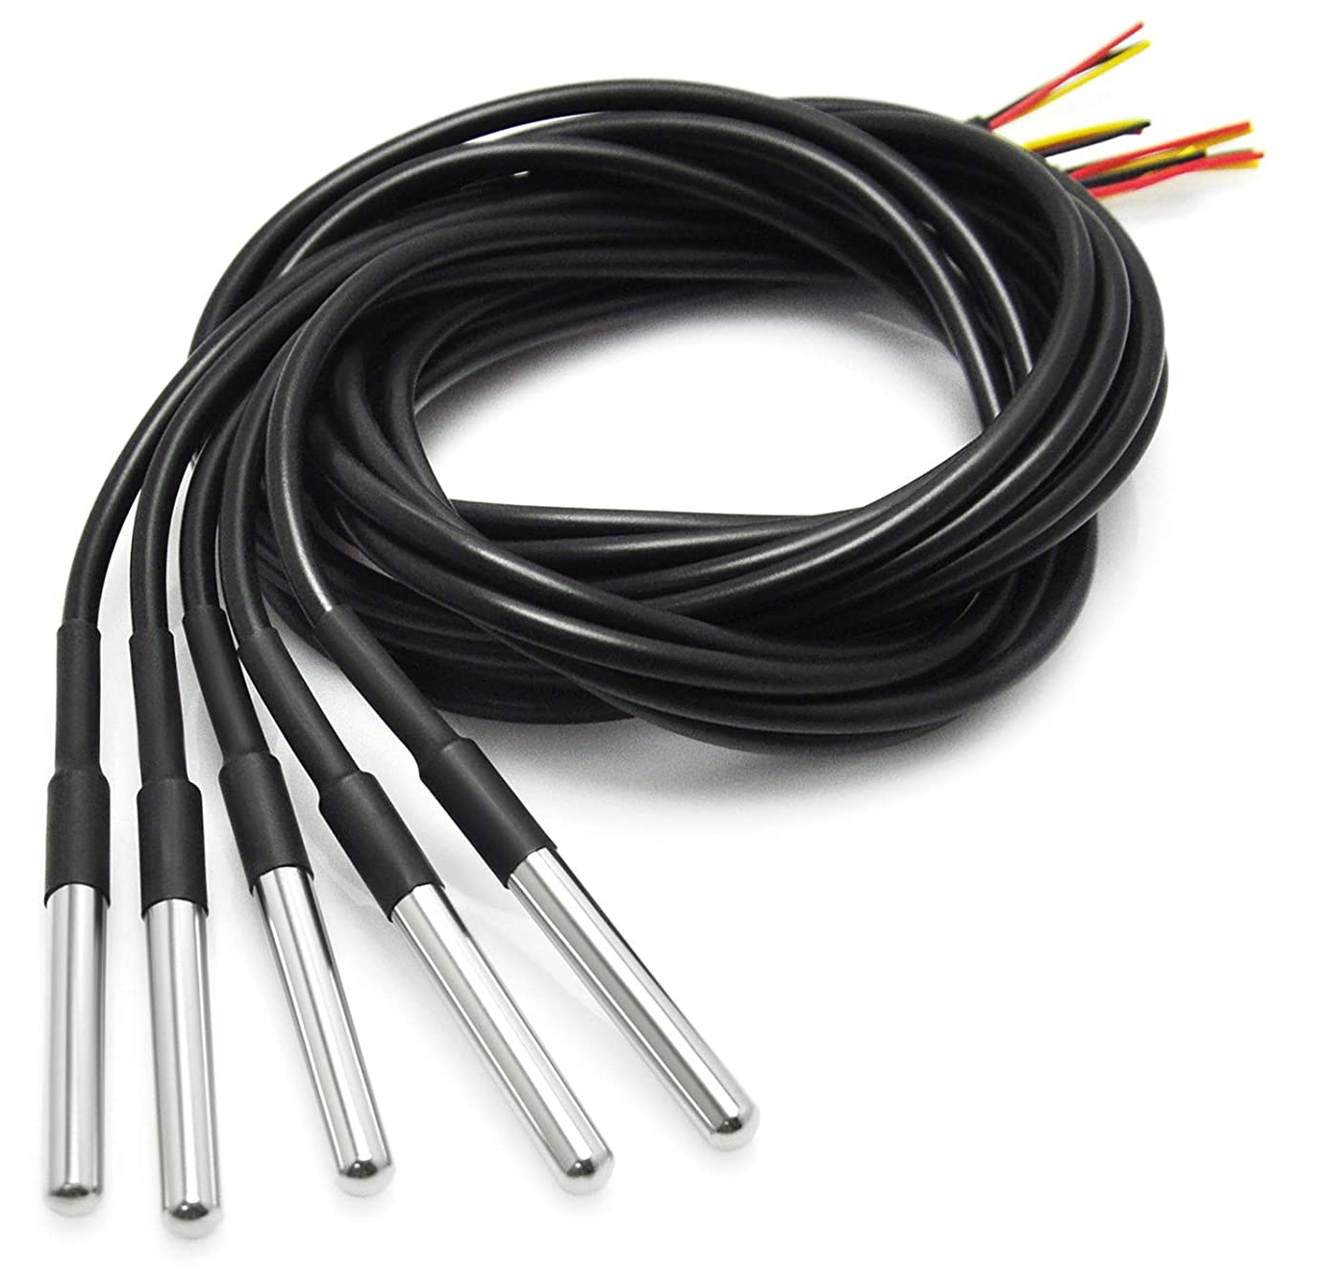
TSE PDR | TEMPERATURE SENSOR SELECTION
TEMPERATURE SESOR | RANGE | ACCURACY | INTERFACE | COST
DHT11 | 0°C - 50°C | ±2°C | Digital | $10 for 5
DS18B20 | -55°C - 125°C | ±0.5°C | Digital, OneWire | $12 for 5
TMP36 | -40°C - 150°C | ±2°C | Analog | $10 for 5
SELECTION: DS18B20
RATIONALE:
  Accurately overs the operating range of the devices inside of the control box.
  Easy to interface with the Arduino via OneWire.

Slide 11
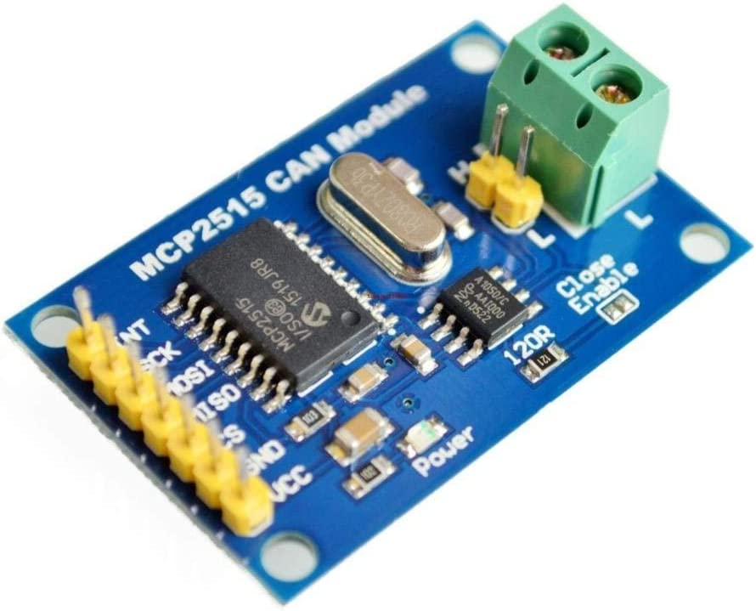
TSE PDR | COMMUNICATION PROTOCOL SELECTION
PROTOCOL | REALISTIC RANGE | ARDUINO DOCUMENTATION | TEMPERATURE RATING | COST
CAN Bus | 40m-1Mbps 1000m-50kbps | Lots with libraries ready | -40°C - 85°C | $11 for 2
RS232 | 15m 100m-750kbps | Decent amount, less libraries | -40°C - 85°C | $7.50 for 5
RS485 | 1000m-60kbps | Decent amount | -40°C - 85°C | $10 for 5
SELECTION: CAN Bus
RATIONALE:
  Easily able to transmit the required distance over a CAT5 ethernet cable.
  Lots of documentation available with the Arduino.

Slide 12
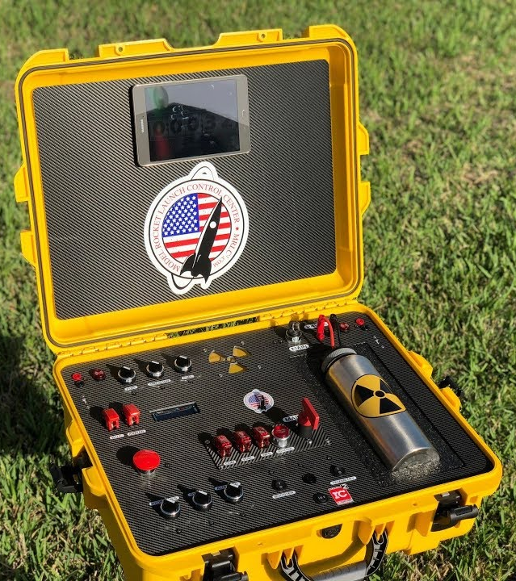
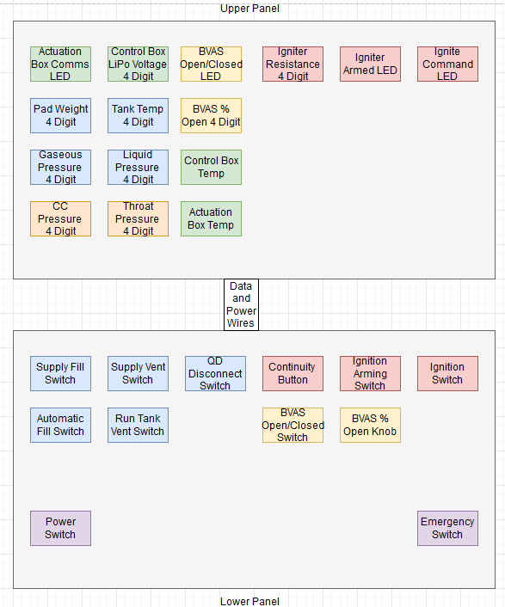
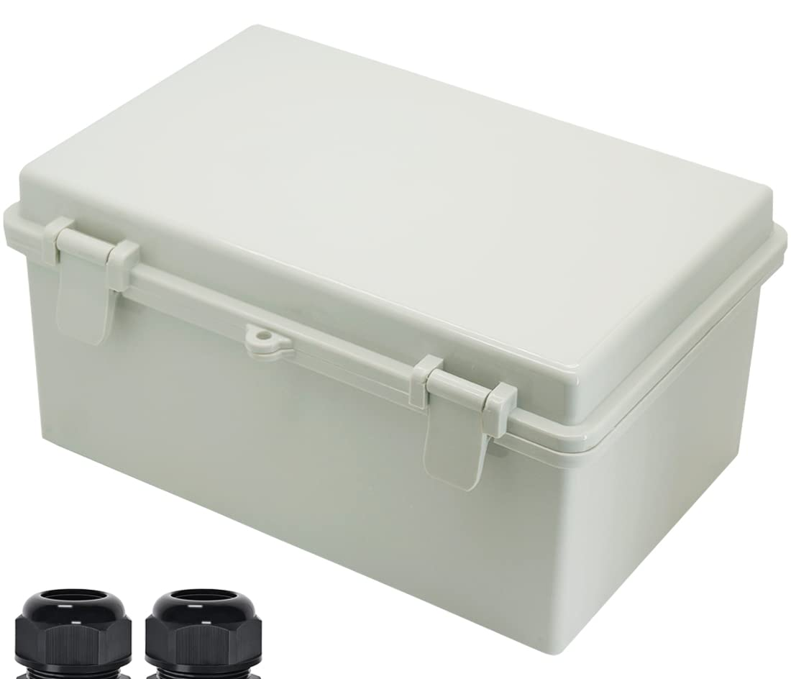
TESTING ELECTRONICS | HOUSINGS
  Control box will be in a waterproof case. An always on cooling fan plus a temperature sensor will help eliminate temperature issues.
  The bottom half will have the switches and knobs required for engine operation.
  The top half will be filled with 7 segment displays for necessary information and indicator LEDs.
  Actuation box will be in an enclosed, plastic project box.

Slide 13
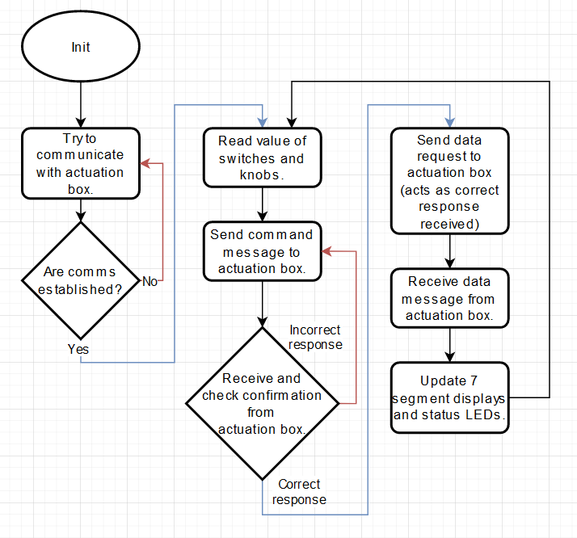
TESTING ELECTRONICS | CONTROL BOX SOFTWARE
  Very high-level loop diagram.
  Command Messages:
    The control box will send the commands to the actuation box.
    The actuation box will receive them and perform some sort of checksum.
    The actuation box will send the checksum back to the command box for it to verify.
    If the message is verified the command box will send a data request message (used to tell the actuation box the message was received correctly).
    If the message is not verified, the command box will reiterate the command message.
Currently looking into other verification methods I’m not aware of.

Slide 14
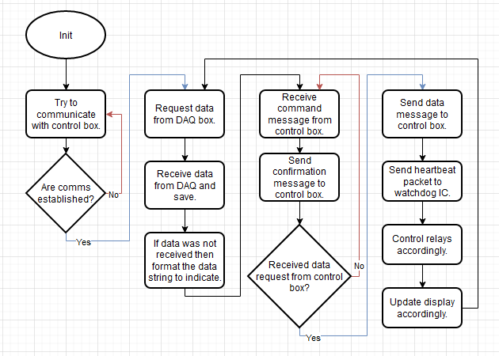
TESTING ELECTRONICS | ACTUATION BOX SOFTWARE
  Very high-level loop diagram.
  DAQ Box Data:
    If the data is received before the data message is requested then great.
    If not, then the actuation box will either report the last known data state with a timestamp to the command box.
    If there is no last known data state, the actuation box will report that to the command box.

Slide 15
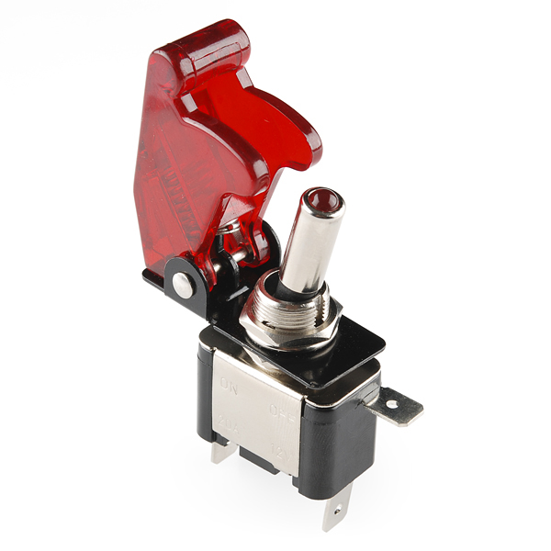
TSE PDR | REDUNDANCY
Control Box Safety Considerations
There will be covers over switches to prevent accidental switches.
For the igniter switch there will be a separate arming switch for extra redundancy.
Actuator Box Safety Considerations
If the actuator box has not received data from the control box, it can assume communication has been lost and revert to a safety state which will close and open the valves and BVAS as needed to return to a safe state.
A continuity check function for the igniter to ensure the igniter is ready and set properly.
Before executing any commands, the actuator box can verify the message it received with the control box via an extra message like a checksum.

Slide 16
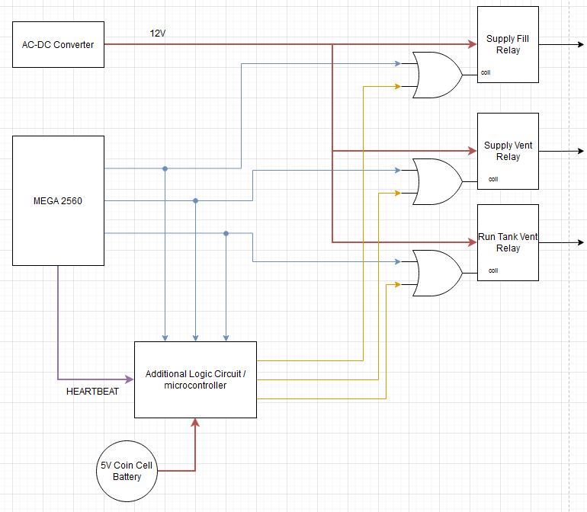
TSE PDR | REDUNDANCY CONTINUED
Actuator Box Fail Safe
The actuation box will be sending a heartbeat signal to a logic circuit outside of its control.
The watchdog will monitor the heartbeat and while it’s stable it will mirror the outputs of the Mega.
If the heartbeat goes adrift for a specified time period, then the watchdog will initiate emergency procedures to return the system to a safe state.
Ideally the watchdog would be digital logic rather than another microcontroller. Thereby having a higher operating temperature range and no software to fail.

Slide 17
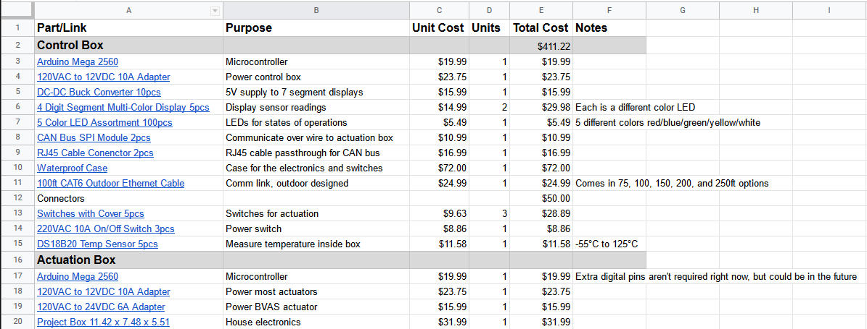
TSE PDR | COST

Slide 18
TSE PDR | SCHEDULE
By October 14
High-level state machine
Communications system designed
Ignitor interface
Fluid systems interface
Logic circuits/PCB complete
Power systems designed
By October 21
Connector/wire harness selection
Software development
By October 28
Physical infrastructure
Component procurement plan
CDR October 29
BOM finalized
By November 11
Full system assembly
By November 25
Communication tests
Ignitor tests
Fluid systems test
Power systems test
Thermal response test
Fail safe tests
SET Ready December 1

